Slide 1
Purpose of local government
My Dad has just paid his rates bill to the council. I’d like to know what they do with all that money.

Slide 2
Local government — who needs it?
What does the government actually do in my community?

Slide 3
Local government — who needs it?
Well, let’s imagine that we don’t have a local government.
What things would you have to do for yourself?

Slide 4
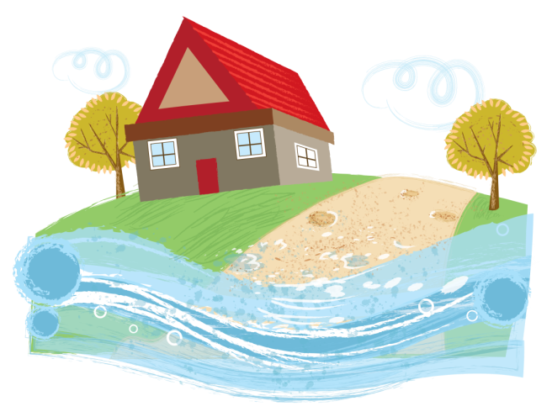
Local government — who needs it?
Your house is on the other side of the creek, so you’d have to build your own bridge to drive to town.

Slide 5
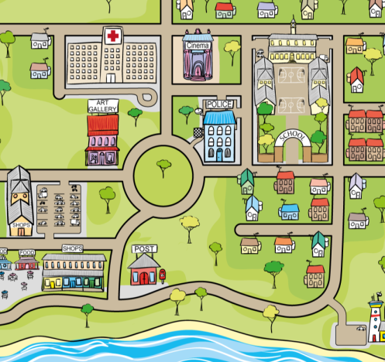
Local government — who needs it?
Yes, I guess someone has to build the streets and parks and bridges — and keep fixing them.

Slide 6
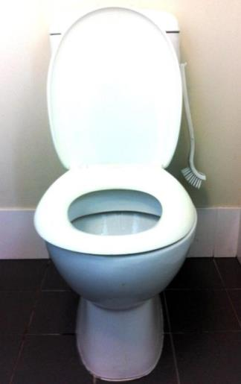
Local government — who needs it?
…and imagine if no-one had built the sewer system that’s connected to your toilet!
Notes:
(Pic: David Fittell)

Slide 7
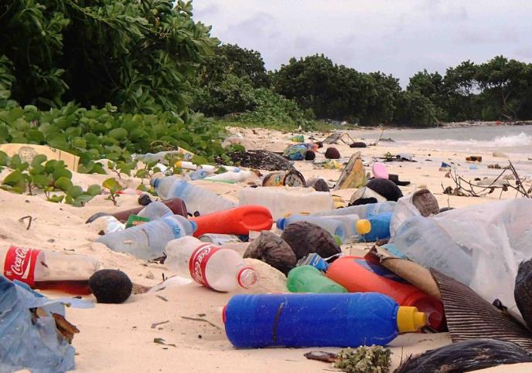
Local government — who needs it?
Hmm… and if council didn’t collect our rubbish and organise somewhere to put it, people would just dump stuff anywhere.
Notes:
(Pic: David Fittell)

Slide 8
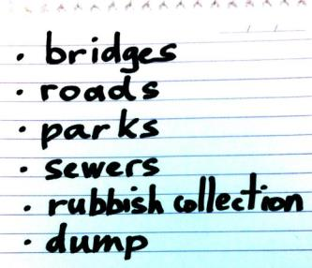
Local government — who needs it?
OK, I’ve listed a few reasons why we need government in our community.
What else can we put on the list?

Slide 9
Attributions
Photo attributions: David Fittell
Toilet (C2c)
Notebook page (c2c)
Beach (personal collection)

