Slide 1
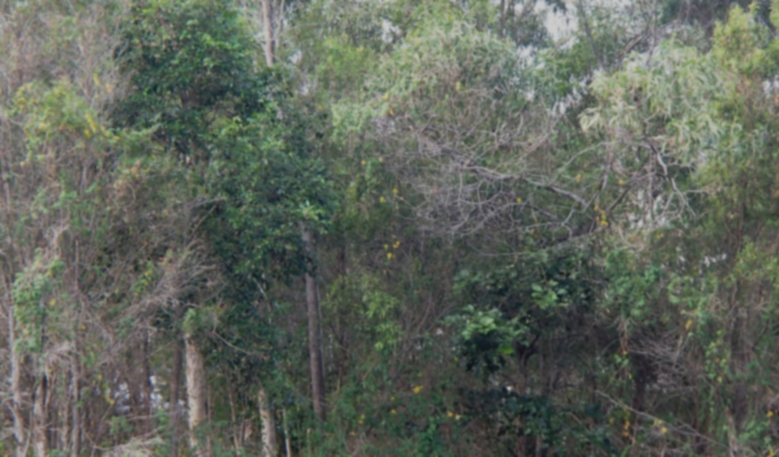
Role-play: Community groups
COUNCIL NOTICE
Community groups are invited to submit proposals to develop this section of the bushland reserve.
The successful group will be granted use of the land as well as development funding.

Slide 2
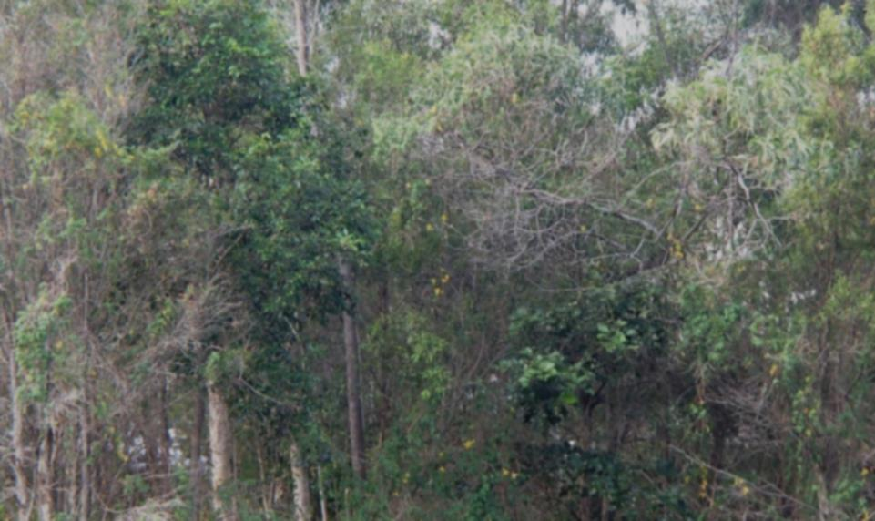
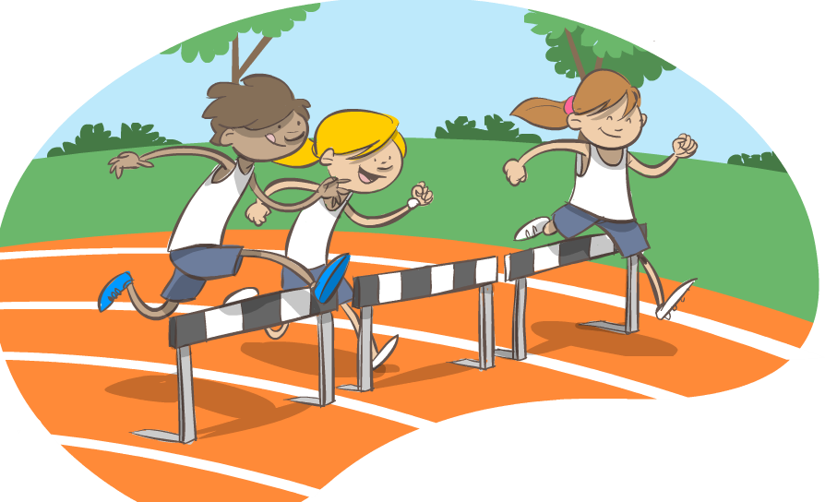
Role-play: Community groups
Athletics club
Why do you think this group formed?
What activities do they do together?
If this group were given the land, what would they like to do with it?

Slide 3
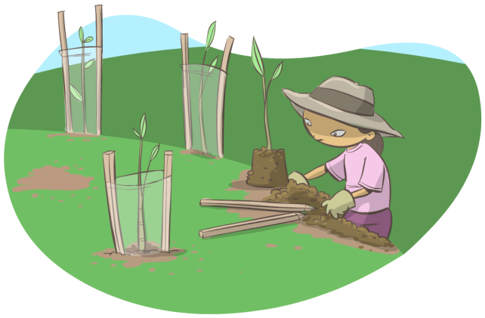
Role-play: Community groups
Land care group
Why do you think this group formed?
What activities do they do together?
If this group were given the land, what would they like to do with it?

Slide 4
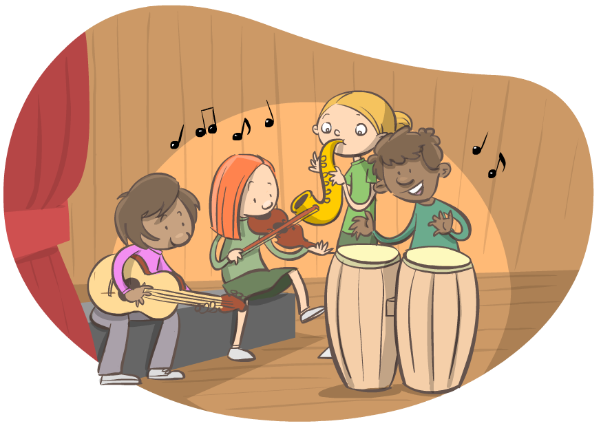
Role-play: Community groups
Music society
Why do you think this group formed?
What activities do they do together?
If this group were given the land, what would they like to do with it?

Slide 5
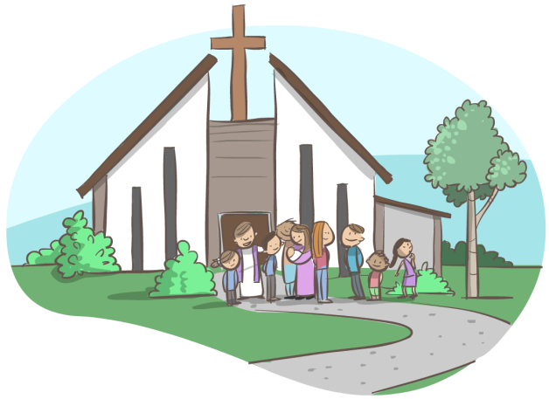
Role-play: Community groups
Uniting Church
Why do you think this group formed?
What activities do they do together?
If this group were given the land, what would they like to do with it?

Slide 6
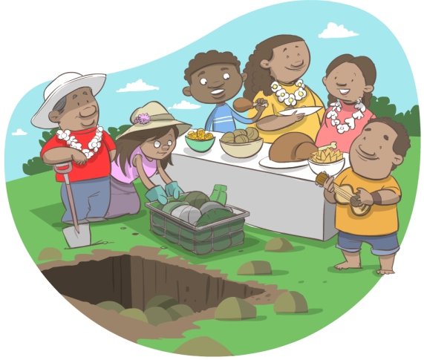
Role-play: Community groups
Polynesian community association
Why do you think this group formed?
What activities do they do together?
If this group were given the land, what would they like to do with it?

Slide 7
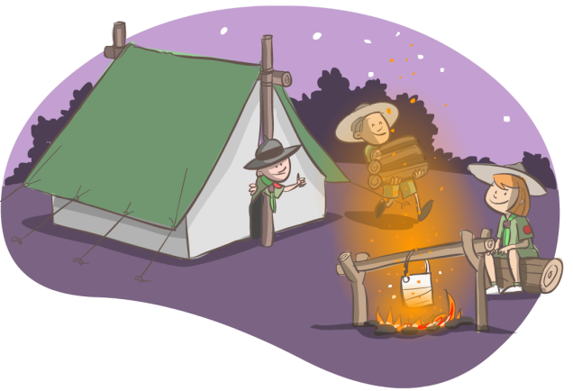
Role-play: Community groups
Scouts and Guides association
Why do you think this group formed?
What activities do they do together?
If this group were given the land, what would they like to do with it?

Slide 8
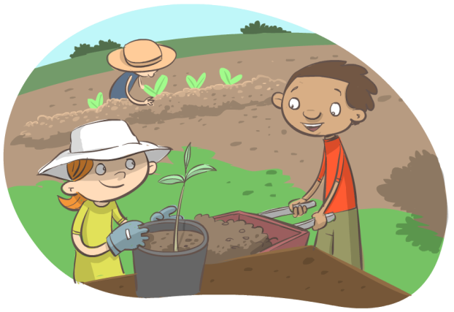
Role-play: Community groups
Community garden society
Why do you think this group formed?
What activities do they do together?
If this group were given the land, what would they like to do with it?

Slide 9
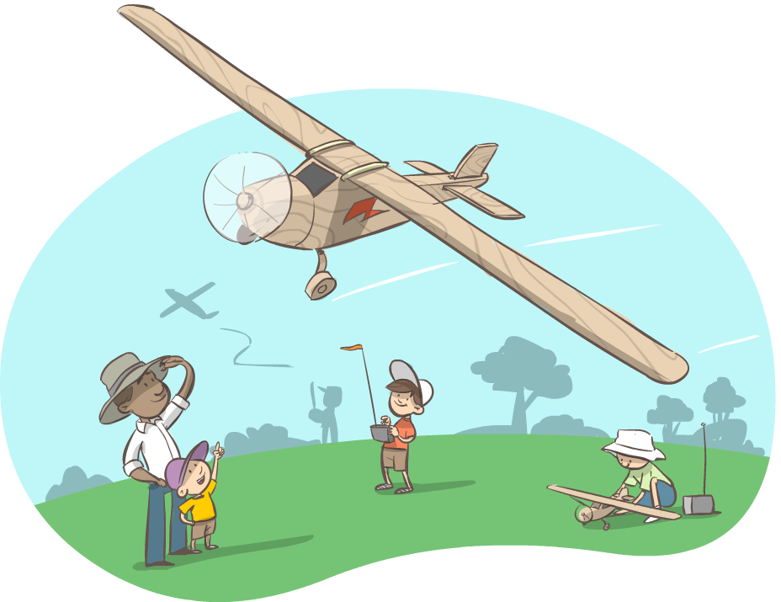
Role-play: Community groups
Model aeroplane club
Why do you think this group formed?
What activities do they do together?
If this group were given the land, what would they like to do with it?

Slide 10
Attributions
Photo attribution:
Background image (bushland)
David Fittell

